Slide 1
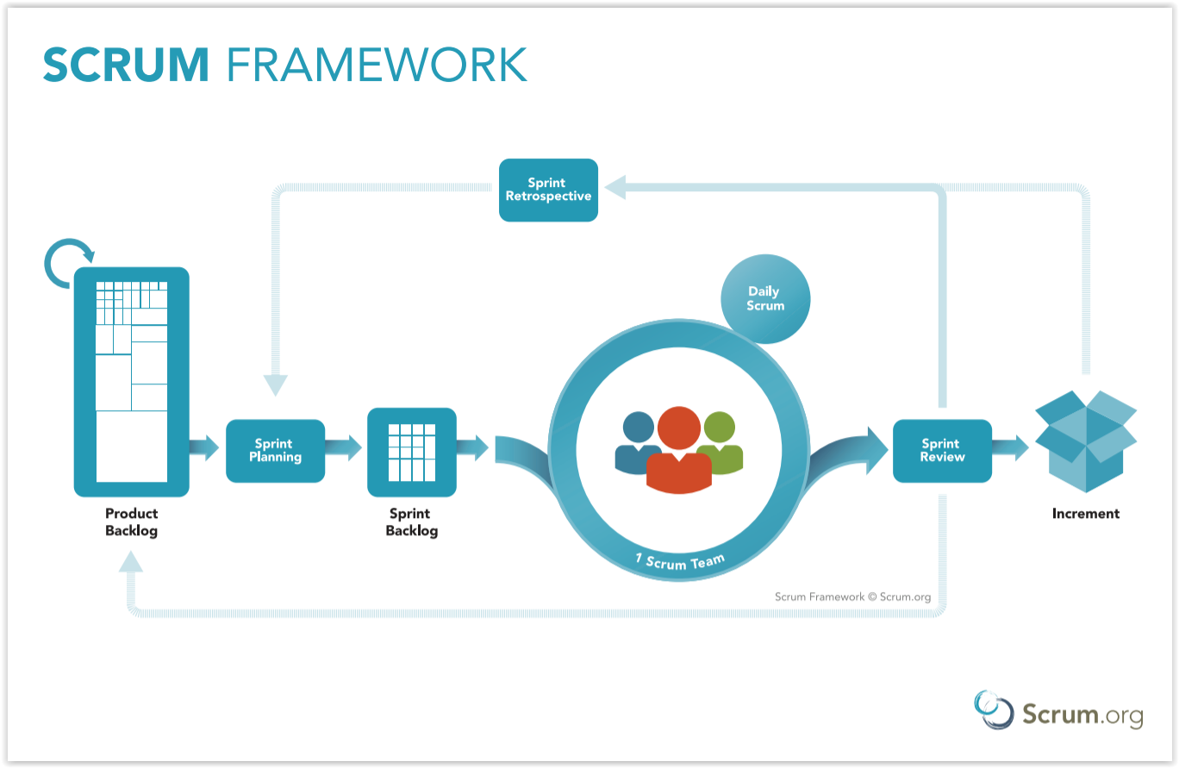
Scrum - an Agile Approach To Project Management
Scrum Master: Jonathan Kleven

Slide 2
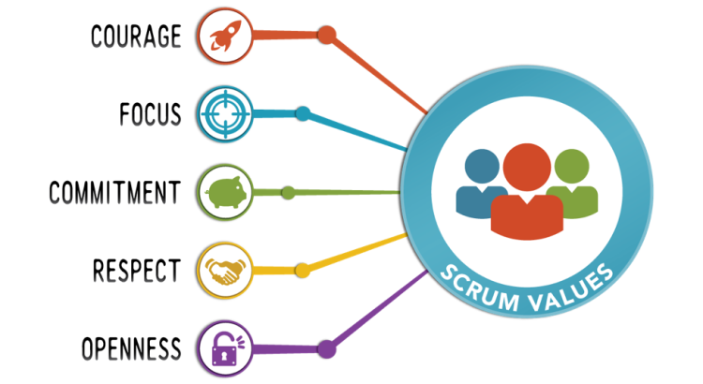
Meet the Scrum Team
Product Owner
Responsible for communicating user and stakeholders' ideas and vision into a useable product
Manages the Product Backlog
Scrum Master
The overseer of the Scrum principles and Guidelines
Mediator of the Team
Servant/leader that works to understand issues and work on solutions to enhance Teams effectiveness

Slide 3
Scrum Team (cont’d)
Developer
Committed members in creating the working solutions of the Product Backlog
Highly flexible Self-sufficient professionals that deploy functional applications in a timely manner
Tester
Outlines the users needs into functional and actionable definitions for Developers
Works with Developers and the Product owner to ensure high quality of the final product

Slide 4
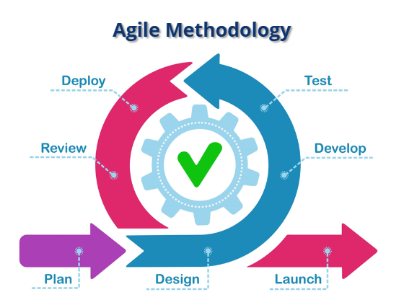
Software Development Life Cycle (SDLC) with an Agile Approach
Agile methodology focuses on constant and consistent planning, development, and quality control to get the best working version as efficiently as possible
Planning
Assess the users needs and organize those needs into the Product Backlog and into workable tasks
Development
Create working applications that meet the users needs
Testing
Employ quality control measures to ensure the applications meet the team and the stakeholder's standards
Review
Look back at what worked and what didn’t, focus on each and deploy controls or changes to ensure the team is as effective as possible

Slide 5
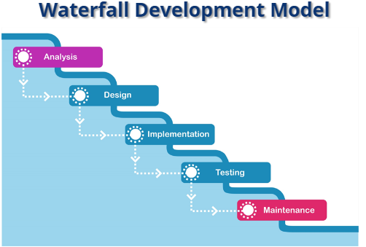
Traditional Waterfall Development
Relies heavily on design and planning
Development and Testing does not begin until near the end of the schedule
Very little time for rework of the application at delivery
Does not consider flexibility

Slide 6
Waterfall vs. Scrum
Suitable for simple projects
Relies on a top-down management approach
Development happens later in the schedule leaving less time for quality controls, revisions, and rework
Best for complex projects
Relies on team for support and execution
Can have one or multiple iterations each result in functional applications

Slide 7
References
CS 250 Software Development Lifecycle Module One: SDLC Methodologies
http://snhu-media.snhu.edu/files/course_repository/undergraduate/cs/cs250/storyline/mod1/story_html5.html
Overeem, Barry (July 2016) Characteristics of a Great Scrum Team. Scrum.org Whitepapers
https://scrumorg-website-prod.s3.amazonaws.com/drupal/2016-08/Characteristics%20of%20a%20Great%20Scrum%20Team.pdf
Schwaber K., & Sutherland J. (2020) The Scrum Guide https://Scrumguides.org/docs/Scrumguide/v2020/2020-Scrum-Guide-US.pdf#zoom=100

